Slide 1
2022 CMOS Congress
Toronto Centre Exhibit

Slide 3
Vacant
Vacant

Slide 8
David Phillips Seminar
Nov 17, 2020

Slide 12
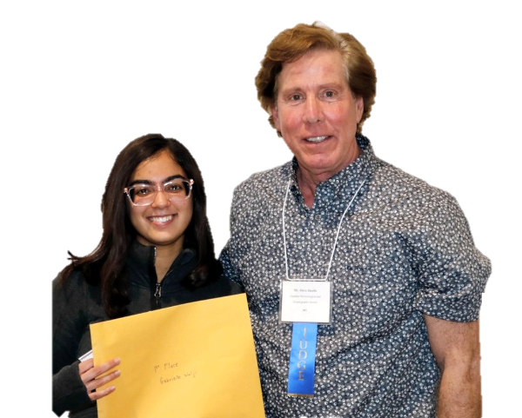
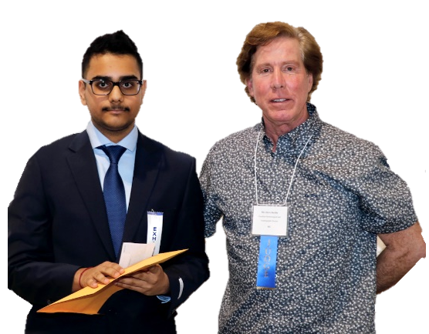
CMOS Toronto Centre
Supporting Student Science Fairs in the GTA
CMOS Toronto Centre’s Steve Jacobs presented first and
second place prize at Toronto Science Fair April 5th and 6th 2019
First place winner: 8th grade Gabrielle Walji with her project "Global Warming's Evil Twin"
Second place winner: 10th grade Krish Dogra with his project “How Acidic is Lake Ontario?"

Slide 13
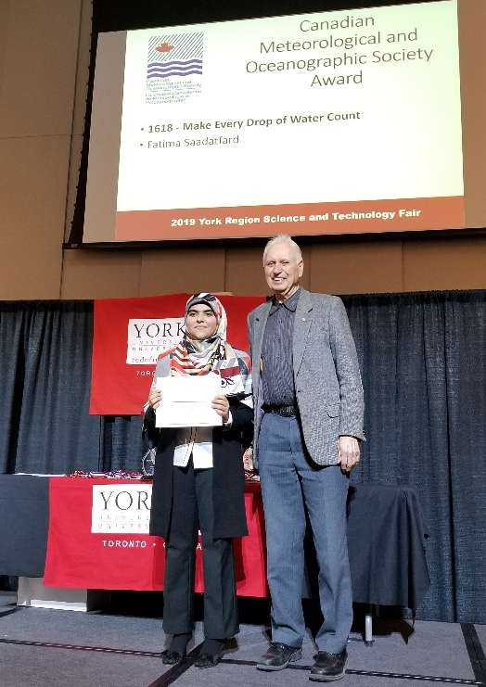
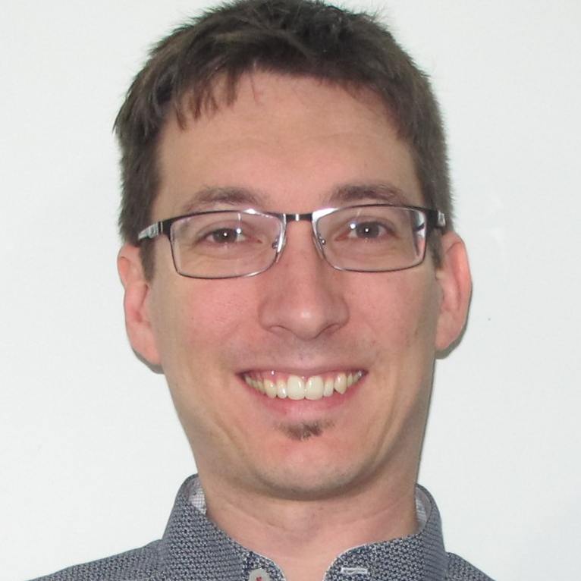
CMOS Toronto Centre
Supporting Student Science Fairs in the GTA
2019 York Region Science and Technology Fair
CMOS Toronto Centre’s Oscar Koren presenting CMOS Award for best meteorology related project
Winner: 8th grade Fatima Saadatfard with her project “Make Every Drop of Water Count”
2021 Virtual BASEF
CMOS Toronto Centre’s Dominique Brunet judged and awarded CMOS Prize

Slide 14
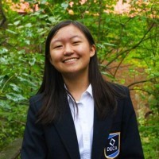
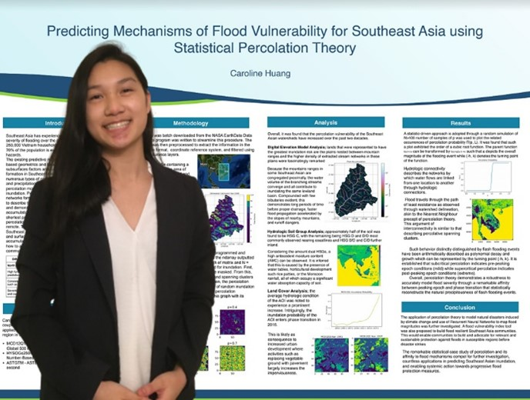
CMOS Toronto Centre
Supporting Student Science Fairs in the GTA
2021 York Region Science and Technology Fair
CMOS Toronto Centre’s Oscar Koren judged and awarded CMOS Prize
2021 Virtual BASEF
CMOS Toronto Centre’s Dominique Brunet judged and awarded CMOS Prize
Sherry Shu
Caroline Huang

